Slide 1
Sons of God:
Walking with God
Gen 1:26-31, Amos 3:3, Matt 4:4
04/03/18

Slide 2
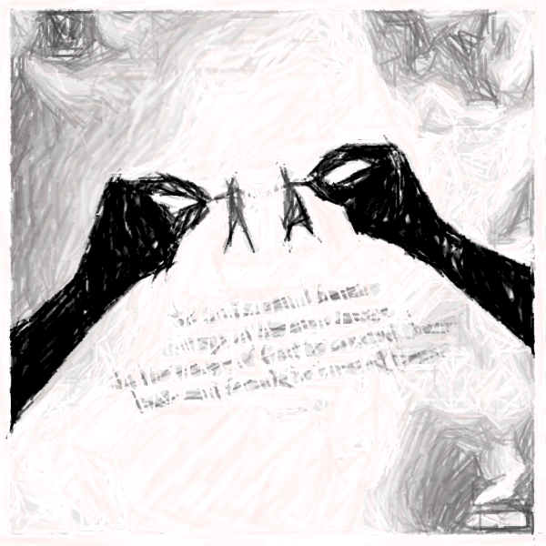
Gen 1:26-31 (Recap)
Created in the image and likeness of God
Created as a spirit being, with soul & body
Created to have a relationship with God*
Created to serve God with His provisions
Created to rule and reign with God
Rom 8:15 - For you did not receive the spirit of bondage again to fear, but you received the Spirit of adoption by whom we cry out, “Abba, Father.”

Slide 3
Gen 1:26-31
²⁶ Then God said,
Let Us make man in Our image,
→ Resemblance = Inward spiritual potential
according to Our likeness,
→ Shape, model = character expressing Him
let them have dominion over the fish of the sea, over the birds of the air, and over the cattle, over all the earth and over every creeping thing that creeps on the earth.”
→ to rule and reign with Him

Slide 4
Gen 1:26-31
²⁷So God created man in His own image; in the image of God He created him; male and female He created them.
²⁸Then God blessed them, and God said to them,
“Be fruitful and multiply;
fill the earth and subdue it;
have dominion over the fish of the sea,
over the birds of the air, and over every living thing that moves on the earth.”
→ Great plan and purpose

Slide 5
Gen 1:26-31
²⁹And God said, “See, I have given you every herb that yields seed which is on the face of all the earth, and every tree whose fruit yields seed; to you it shall be for food. ³⁰ Also, to every beast of the earth, to every bird of the air, and to everything that creeps on the earth, in which there is life, I have given every green herb for food”; and it was so.
→ With all provision
³¹ Then God saw everything that He had made, and indeed it was very good. So the evening and the morning were the sixth day.

Slide 6
Matt 6:25-33
“Therefore I say to you, do not worry about your life, what you will eat or what you will drink; nor about your body, what you will put on. Is not life more than food and the body more than clothing?
Look at the birds of the air, for they neither sow nor reap nor gather into barns; yet your heavenly Father feeds them. Are you not of more value than they? Which of you by worrying can add one cubit to his stature? “So why do you worry about clothing? Consider the lilies of the field, how they grow: they neither toil nor spin; and yet I say to you that even Solomon in all his glory was not arrayed like one of these.

Slide 7
Matt 6:25-33
Now if God so clothes the grass of the field, which today is, and tomorrow is thrown into the oven, will He not much more clothe you, O you of little faith?
“Therefore do not worry, saying, ‘What shall we eat?’ or ‘What shall we drink?’ or ‘What shall we wear?’ For after all these things the Gentiles seek. For your heavenly Father knows that you need all these things.
But seek first the kingdom of God and His righteousness, and all these things shall be added to you.

Slide 8
Relationship with God
Walking with God (Gen 5:24)
a. God desires to walk with us.
“And Enoch walked with God; and he was not, for God took him.”
Gen 3:8-9 – God looked for Adam & Eve
Rom 5:8 – While we were sinners, Christ died for us.
Matt 1:21 – Jesus = He shall save His people from their sin.
James 2:23 - Abraham = a friend of God

Slide 9


Relationship with God
Walking with God (Gen 5:24)
Fellowship (koinonia) = intimacy & communion
Fellowship with the Father is through Jesus
1 Cor 1:9 God is faithful,
by whom you were called
into the fellowship of his Son,
Jesus Christ our Lord.

Slide 10
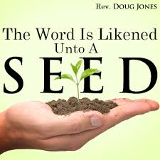
Relationship with God
2. Receiving from God “Word” (Matt 4:4)
a. Word of God = Life
‘Man shall not live on bread alone, but on every word that comes from the mouth of God.’
Luke 8:11 - The seed is the word of God.
John 6:63 - It is the Spirit who gives life;
the flesh profits nothing.
The words that I speak to you are
spirit, and they are life.

Slide 11
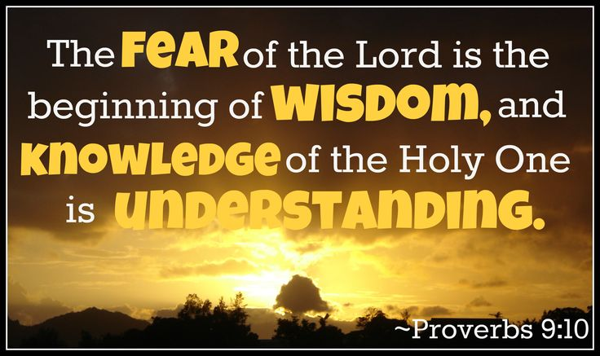
Relationship with God
2. Receiving “word” from God (Matt 4:4)
b. Word of God = wisdom
Gen 2:19 – Adam received wisdom to name the animals.
Gen 6:22 - Thus Noah did; according to all that God commanded him, so he did

Slide 12
Relationship with God
2. Receiving “word” from God (Matt 4:4)
c. Word of God = Instruction (obedience)
Gen 26:2-5 Then the Lord appeared to him and said: “Do not go down to Egypt; live in the land of which I shall tell you. Dwell in this land, and I will be with you and bless you; for to you and your descendants I give all these lands, and I will perform the oath which I swore to Abraham your father. And I will make your descendants multiply as the stars of heaven; I will give to your descendants all these lands; and in your seed all the nations of the earth shall be blessed; because Abraham obeyed My voice and kept My charge, My commandments, My statutes, and My laws.”

Slide 13
Relationship with God
3. Agreeing with God (Amos 3:3)
Can two walk together, unless they are agreed?
James 2:23, “Abraham believed God,
and it was counted to him as righteousness”
- and he was called a friend of God.
Gen 2:15 – The authority given to Adam to rule and reign is dependent on his obedience (v16).
Have dominion over your own free will.
Gen 4:17 - sin lies at the door. And its desire is for you, but you should rule over it.”

Slide 14
Conclusion
We were created to be sons of God with great potential, blessed with provisions needed to fulfil His plan and purposes.
Man through Jesus are going towards perfection but an adversary is out there to stop us.
Jesus restored what Adam lost and showed us how to live as sons of God
(as man filled with the Spirit of God).

